Slide 1
SMART TALKS 132: Machine Learning
Build machine learning applications using R and Python in SQL Server 2017
Andrii Shchur
anshc@smart-it.com

Slide 2

Andrii Shchur
Data science engineer
Education:
Kyiv National Economic University named after Vadym Hetman, Institute Information Technologies in Economics,
Master's degree — «System analysis»
Microsoft Certified Solutions Associate - Machine Learning
Microsoft Certified Solutions Expert - Data Management and Analytics
Experience:
Sales analyst (internship) – SC Adidas Ukraine
Planning department intern – Danone
Analyst – P&G
Analyst – Henkel
Data science engineer – SMART business

Slide 3
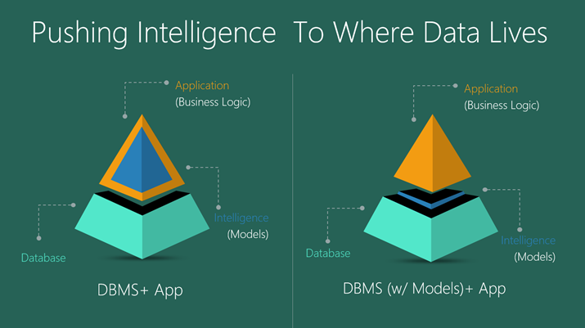
SQL + MACHINE LEARNING

Slide 4
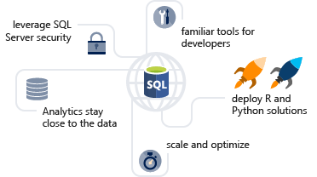
SQL + MACHINE LEARNING

Slide 5
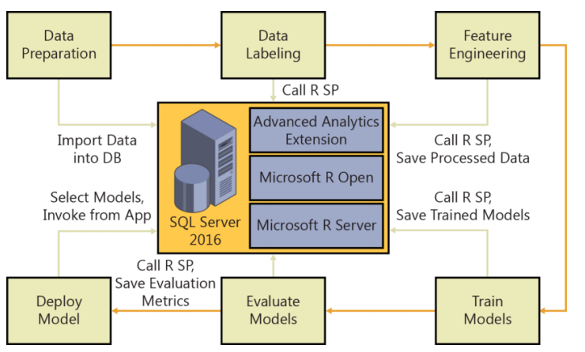
Автоматизация рабочих процессов

Slide 6
SQL SERVER 2017 vs SQL SERVER 2016
SQL Server 2017
Поддержка R + Python
Название – «Machine Learning Services»
SQL Server 2016
Поддержка R
Название – «R Services»

Slide 7
Технические требования
SQL:
SQL Server 2017, Служба машинного обучения, с языком R
SQL Server 2016, R Services
IDE
SQL Server Management Studio (SSMS)
Visual Studio (Data Science and Analytical Applications )

Slide 8
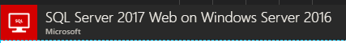
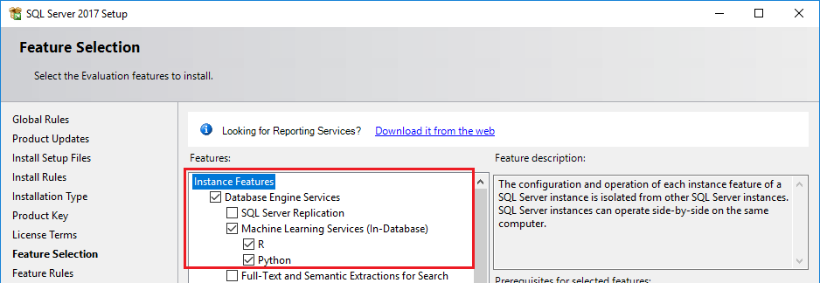
Установка и настройка необходимого ПО
SQL
SQL Server 2017 on Azure
SQL Server 2017 On-Prem (Machine Learning in SQL Server 2017)
https://www.microsoft.com/ru-ru/sql-server/sql-server-downloads

Slide 9
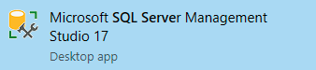
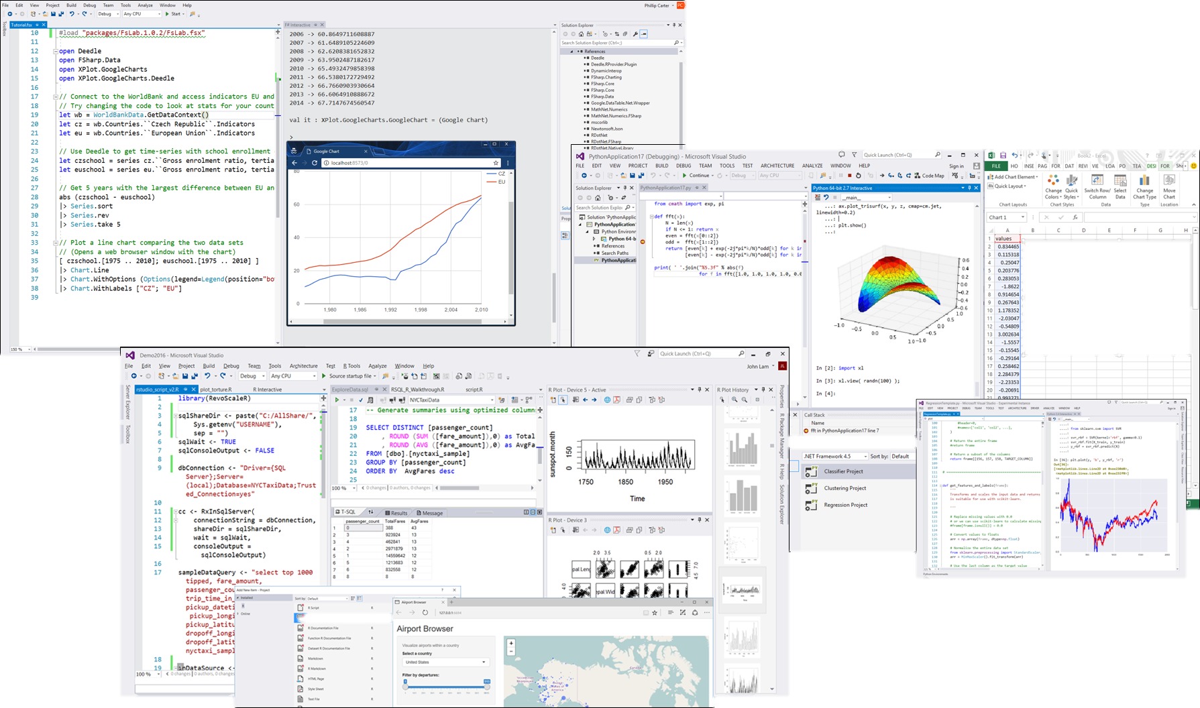

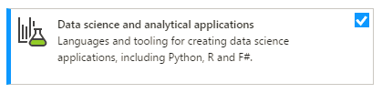
Установка и настройка необходимого ПО
IDE
https://docs.microsoft.com/ru-ru/sql/ssms/download-sql-server-management-studio-ssms
https://www.visualstudio.com/ru/?rr=https%3A%2F%2Fwww.google.com.ua%2F

Slide 10
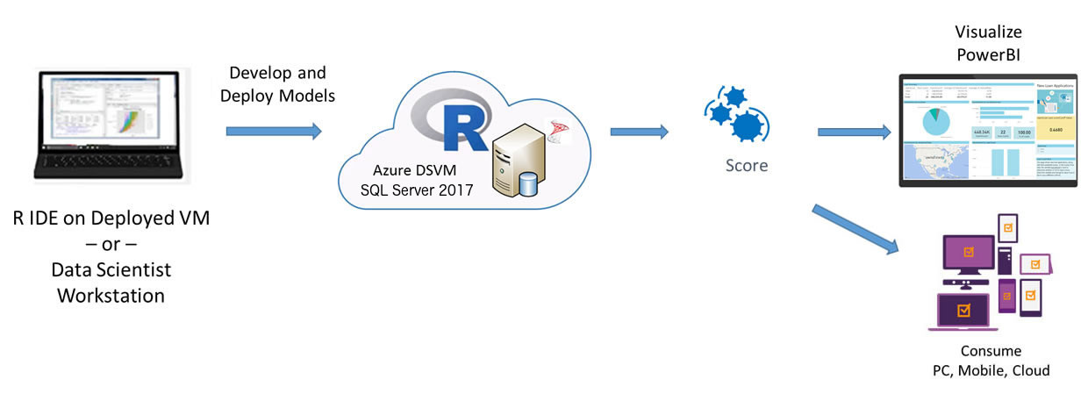
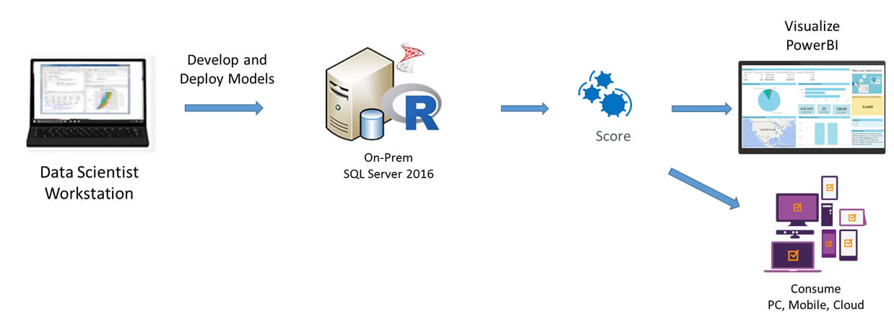
Будущая архитектура
SQL Server 2017 on Azure
SQL Server 2017 On-Prem

Slide 11
DEMO

Slide 12
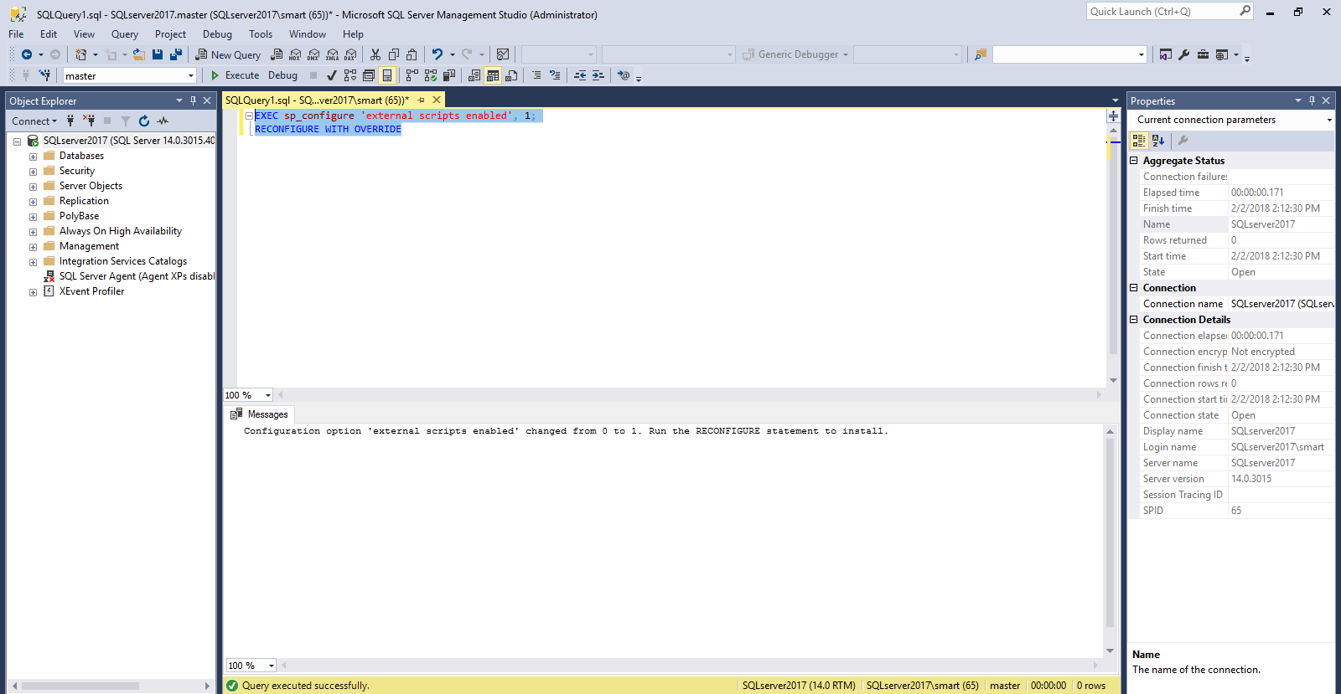
Настройка SQL Server 22017

Slide 13
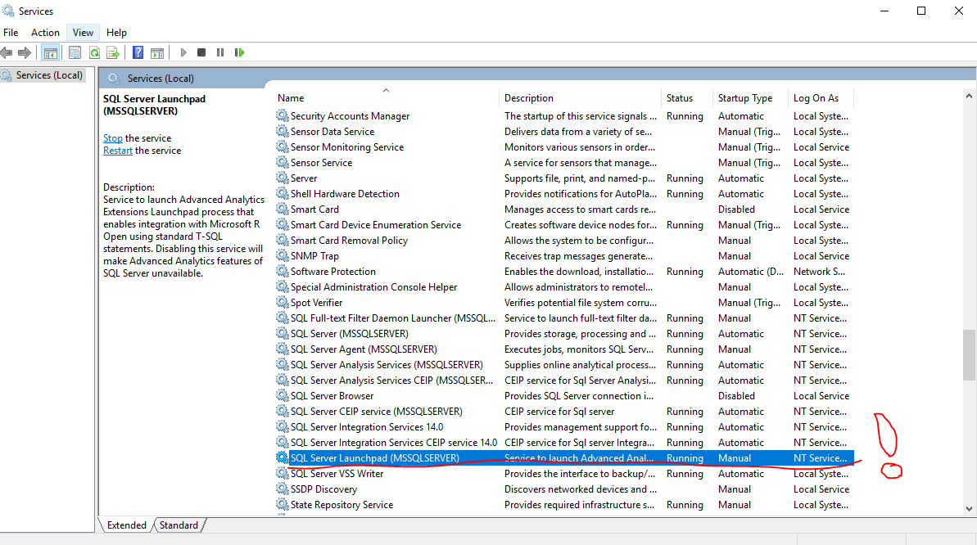
Настройка SQL Server 22017

Slide 14
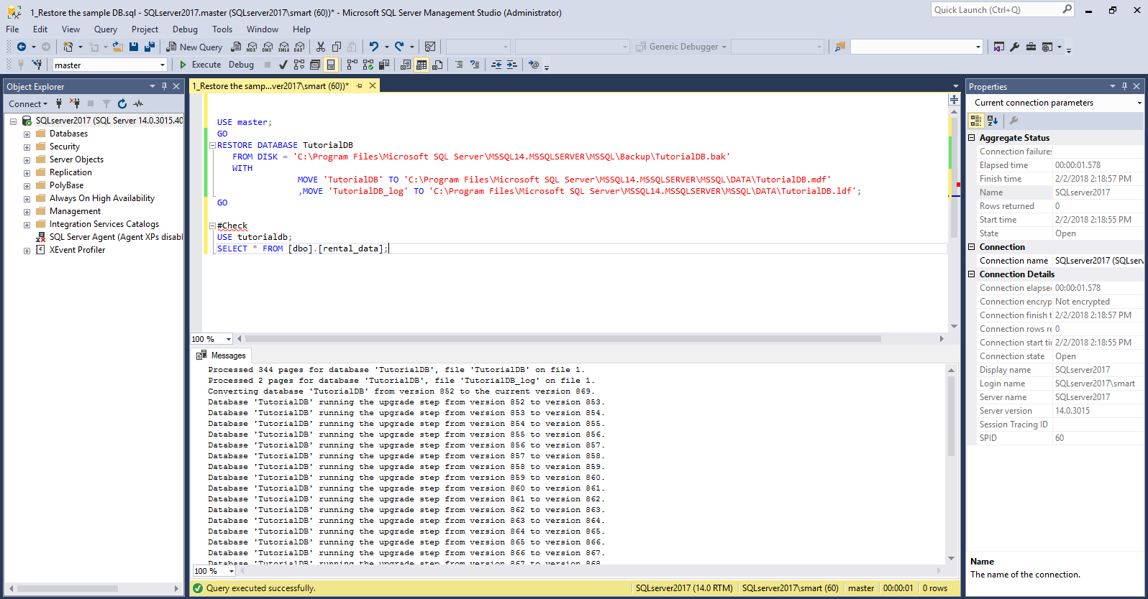
Загрузка тестовых данных

Slide 15
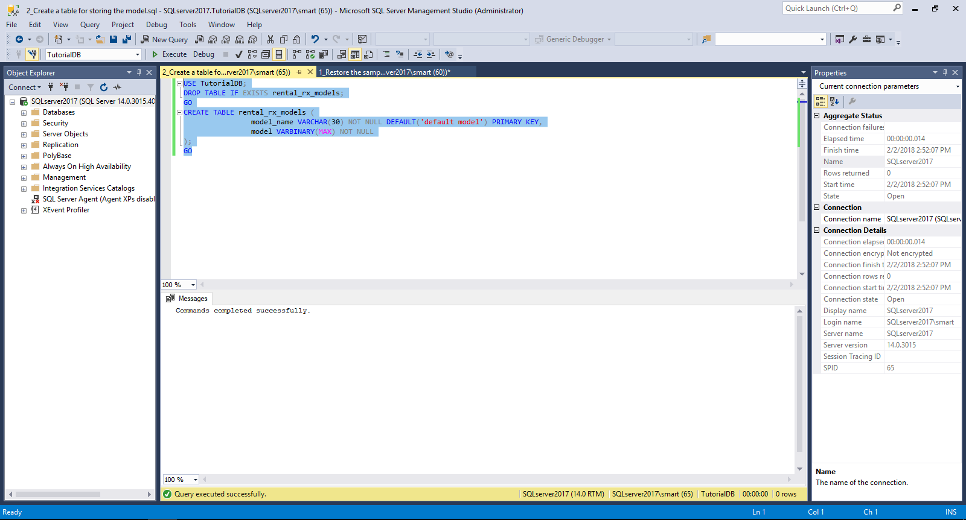
Подготовка таблицы для модели

Slide 16
Подготовка таблицы для модели и процедура обучения
-- Stored procedure that trains and generates an R model using the rental_data and a decision tree algorithm
DROP PROCEDURE IF EXISTS generate_rental_rx_model;
go
CREATE PROCEDURE generate_rental_rx_model (@trained_model varbinary(max) OUTPUT)
AS
BEGIN
EXECUTE sp_execute_external_script
@language = N'R'
, @script = N'
require("RevoScaleR");
rental_train_data$Holiday = factor(rental_train_data$Holiday);
rental_train_data$Snow = factor(rental_train_data$Snow);
rental_train_data$WeekDay = factor(rental_train_data$WeekDay);
#Create a dtree model and train it using the training data set
model_dtree <- rxDTree(RentalCount ~ Month + Day + WeekDay + Snow + Holiday, data = rental_train_data);
#Before saving the model to the DB table, we need to serialize it
trained_model <- as.raw(serialize(model_dtree, connection=NULL));'
, @input_data_1 = N'select "RentalCount", "Year", "Month", "Day", "WeekDay", "Snow", "Holiday" from dbo.rental_data where Year < 2015'
, @input_data_1_name = N'rental_train_data'
, @params = N'@trained_model varbinary(max) OUTPUT'
, @trained_model = @trained_model OUTPUT;
END;
GO

Slide 17
Сохраняем модель
-- Save model to table
TRUNCATE TABLE rental_rx_models;
DECLARE @model VARBINARY(MAX);
EXEC generate_rental_rx_model @model OUTPUT;
INSERT INTO rental_rx_models (model_name, model) VALUES('rxDTree', @model);
SELECT * FROM rental_rx_models;

Slide 18
Процедура для прогноза
--Stored procedure that takes model name and new data as input parameters and predicts the rental count for the new data
DROP PROCEDURE IF EXISTS predict_rentalcount_new;
GO
CREATE PROCEDURE predict_rentalcount_new (@model VARCHAR(100),@q NVARCHAR(MAX))
AS
BEGIN
DECLARE @rx_model VARBINARY(MAX) = (SELECT model FROM rental_rx_models WHERE model_name = @model);
EXECUTE sp_execute_external_script
@language = N'R'
, @script = N'
require("RevoScaleR");
#The InputDataSet contains the new data passed to this stored proc. We will use this data to predict.
rentals = InputDataSet;
#Convert types to factors
rentals$Holiday = factor(rentals$Holiday);
rentals$Snow = factor(rentals$Snow);
rentals$WeekDay = factor(rentals$WeekDay);
#Before using the model to predict, we need to unserialize it
rental_model = unserialize(rx_model);
#Call prediction function
rental_predictions = rxPredict(rental_model, rentals);'
, @input_data_1 = @q
, @output_data_1_name = N'rental_predictions'
, @params = N'@rx_model varbinary(max)'
, @rx_model = @rx_model
WITH RESULT SETS (("RentalCount_Predicted" FLOAT));
END;
GO

Slide 19
Выполняем процедуру прогноза
--Execute the predict_rentals stored proc and pass the modelname and a query string with a set of features we want to use to predict the rental count
EXEC dbo.predict_rentalcount_new @model = 'rxDTree',
@q ='SELECT CONVERT(INT, 3) AS Month, CONVERT(INT, 24) AS Day, CONVERT(INT, 4) AS WeekDay, CONVERT(INT, 1) AS Snow, CONVERT(INT, 1) AS Holiday';
GO

Slide 20
Тестируем новую функцию прогноза
-- STEP 4 - Use the native PREDICT (native scoring) to predict number of rentals for both models
--Now lets predict using native scoring with linear model
DECLARE @model VARBINARY(MAX) = (SELECT TOP(1) native_model FROM dbo.rental_models WHERE model_name = 'linear_model' AND lang = 'R');
SELECT d.*, p.* FROM PREDICT(MODEL = @model, DATA = dbo.rental_data AS d) WITH(RentalCount_Pred float) AS p;
GO
--Native scoring with dtree model
DECLARE @model VARBINARY(MAX) = (SELECT TOP(1) native_model FROM dbo.rental_models WHERE model_name = 'dtree_model' AND lang = 'R');
SELECT d.*, p.* FROM PREDICT(MODEL = @model, DATA = dbo.rental_data AS d) WITH(RentalCount_Pred float) AS p;
GO

Slide 21
Никаких проблем с дополнительными библиотеками
EXEC sp_execute_external_script
@language =N'R',
@script=N'
# install randomForest and its dependencies
library(randomForest)'

Slide 22
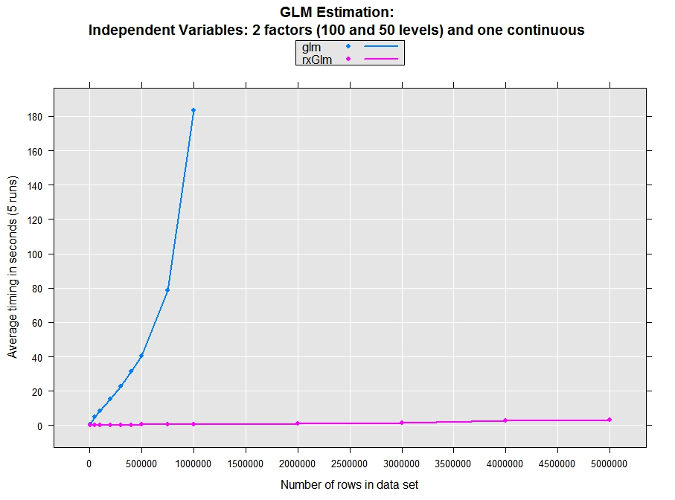
Производительность

Slide 23
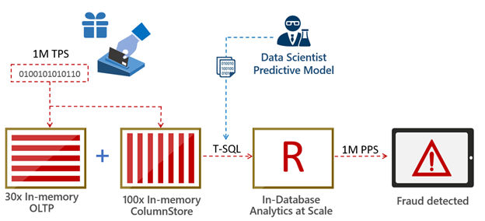
Predict a million events per second
A data scientist creates a predictive model for credit-card fraud detection based on historical transaction data. This model is stored as a standard database object.
New credit-card transactions are ingested and stored in high-speed in-memory columnstores.
The data is likely to require some preparation for advanced analytics. This includes operations such as joining data across multiple tables, cleansing, creating aggregations and more. SQL shines here because these steps execute much faster in production when done at the database layer.
The new transaction data and the predictive model are sent using T-SQL to an in-database predictive engine. Predictions can be done in batch or at the single transaction level. In SQL Server 2016 you can build on the power of R, with its extensive set of packages and the built-in high scale algorithmic library (ScaleR) provided by Microsoft.
Predictions can be retuned immediately to an application via T-SQL and/or stored in the database for further use.

Slide 24
Links
Официальная документация Machine Learning Services
https://docs.microsoft.com/en-us/sql/advanced-analytics/getting-started-with-machine-learning-services
Официальная документация SQL Server 2017
https://docs.microsoft.com/en-us/sql/sql-server/what-s-new-in-sql-server-2017
Официальная документация VS Data Science and Analytical Applications
https://docs.microsoft.com/en-us/visualstudio/rtvs/data-science-and-analytical-applications-workload

